Slide 1
Gas density in merging quenched dwarf galaxies
By Kristian Knudsgaard, Lea Krarup, and Carol Dong

Slide 2
Theoretical background
Merging will trigger star-forming
There are observed starburst activities at the interaction areas(Gao et al. 2023)
Minor mergers are likely to be a major driver for sf (Rathore et al. 2023)
There is enough molecular gas present in close pairs to fuel the starburst (Reeves & Hudson 2024)
Merging can not trigger but stop star-formation
Galaxy mergers is identified as potent mechanisms for quenching of star-formation.(Croton et al. 2006; Gabor et al. 2010; Bluck et al. 2020).
galaxy mergers, including those that involve gas-rich and nearly equal-mass galaxies, exert a minimal impact on their SFR, specific SFR, or star formation efficiency.(Li et al. 2023)
Mix
Mergers have little effect on SFR, but can induce starbursts (Pearson et al. 219)

Slide 3
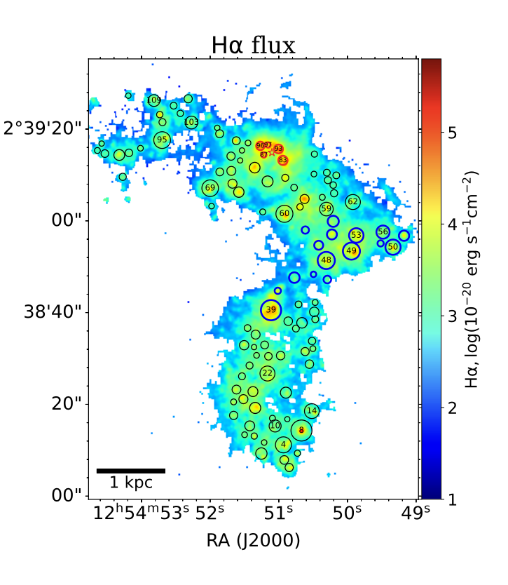
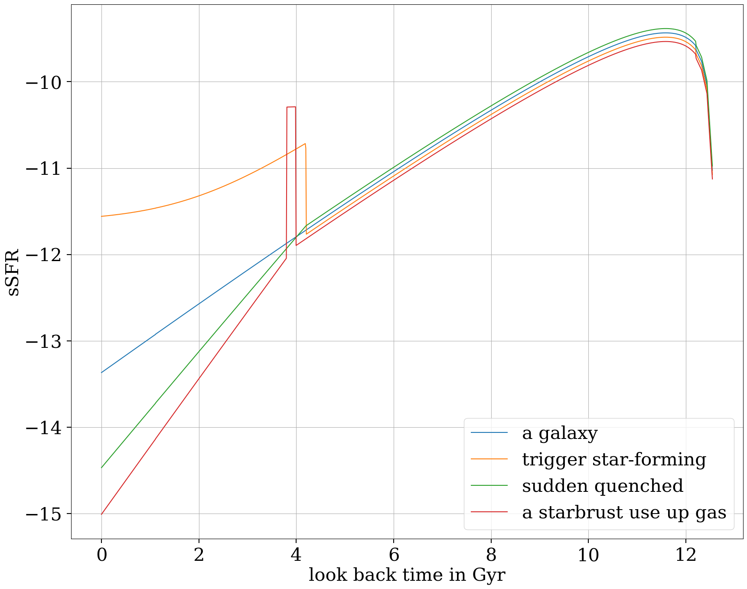
What we might observe
(Gao et al. 2023)

Slide 4
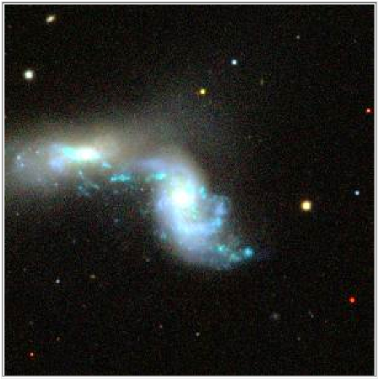
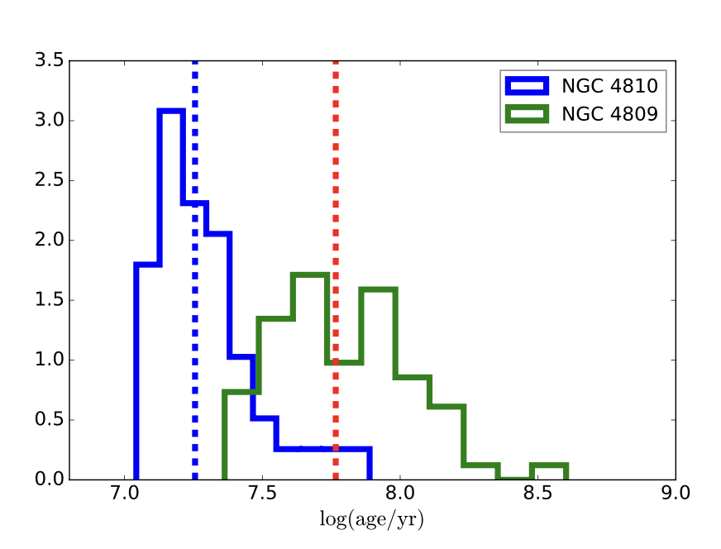
J104950.09+325857.9 by sdss
(Gao et al. 2023)

Slide 5
The key: gas
The decrease in SFR is due to the consumption of molecular gas by the starburst. (Baron et al. 2023)
There is enough molecular gas present in close pairs to fuel the starburst (Reeves & Hudson 2024)
Stars are born from gas (Common Sense)
Minor mergers are likely to be a major driver for star-forming through bring gas (Rathore et al. 2023)
Galaxies may still be quenched if they have plenty of cold gas but do not form star efficiently. (Luo et al. 2020)

Slide 6
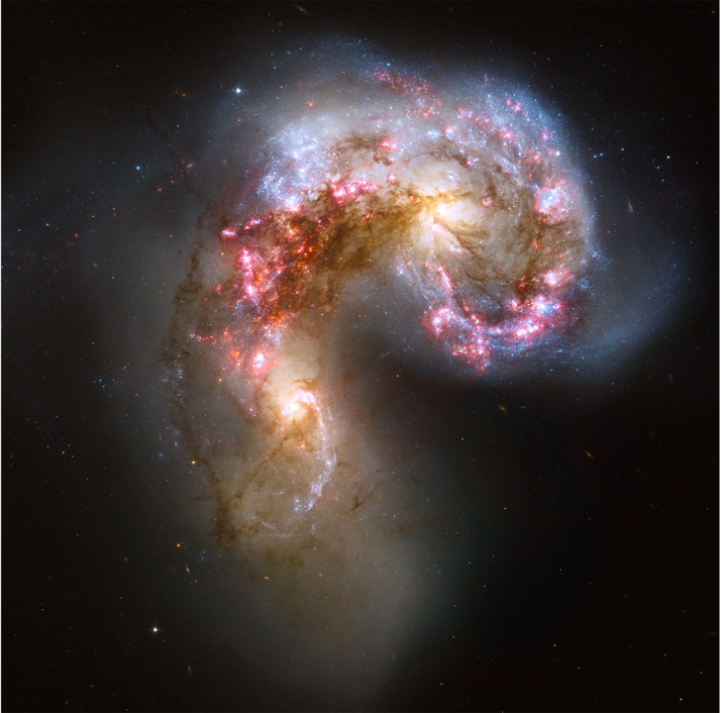
Conclusion poem
Gas, gas, gas, without you no stars can be formed.
Merging brings gas fuel stars to born.
Using up the last gas this pair owned.
Formation stops as gas gone.
That is the starburst we called.
After the merging, little gas remained, the merger goes into its good night.
Sigh, sigh for the dying of the light.
NGC 4038/4039 by HST

Slide 7
Methodology
Set up of galaxy particles:
Galactics for stars/dark matter particles (only occupying bulge, to create dwarf galaxy shape)
Make two galaxies and add them into one
Molecular_cloud code for gas particles
Hydrodynamical code (fi) for gas
Barnes-Hut tree (bh-tree) for stars/dark matter, gravitational background
Bridge between hydrodynamical with gravitational code

Slide 8
Initial conditions
Number of particles
10.000 gas particles
20.000 stars
Masses
Gas: 10⁸ solar masses
Stars: 10⁹ solar masses
Sizes
Gas cloud: 3 kpc
Galaxies: 3 kpc
Position/Distance
Initial distance ~45 kpc → close enough for merger to occur without initial velocity
Velocity
Parameter that we varied to simulate both major and minor merger
Timescale
3000 Myr

Slide 9
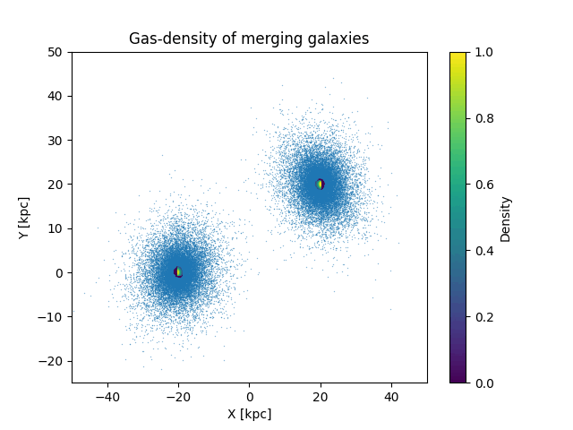
Results
Initial velocity 0 km s⁻¹
Major merger
First pass at ≅700 Myr
Merger at ≅900 Myr
Mixing and slowly expanding
until 3000 Myr

Slide 10
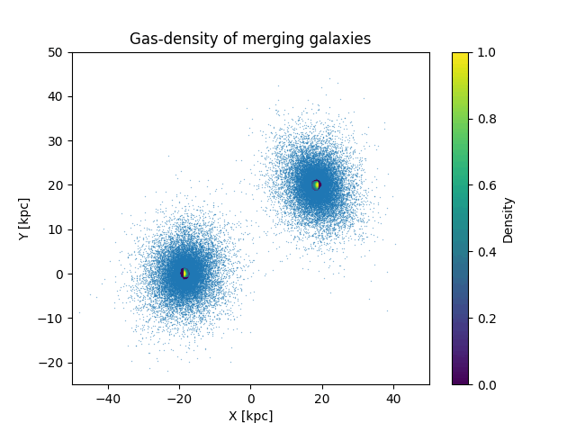
Results
Initial velocity 30 km s⁻¹
Major merger
Merger at ≅700 Myr

Slide 11
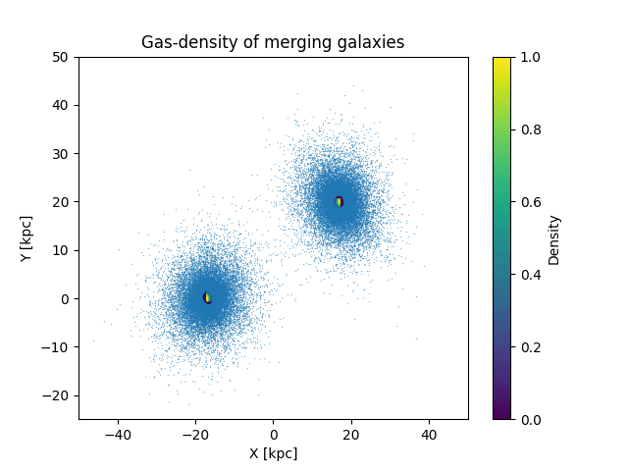
Results
Initial velocity 60 km s⁻¹
Minor merger
Graze at ≅300 Myr

Slide 12
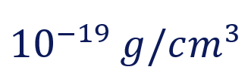
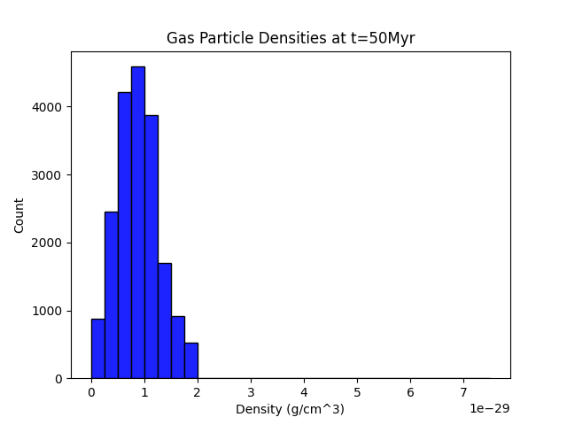
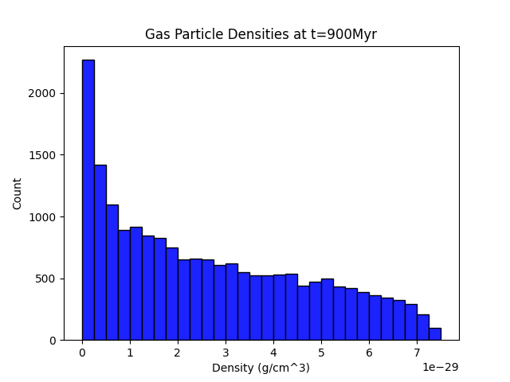
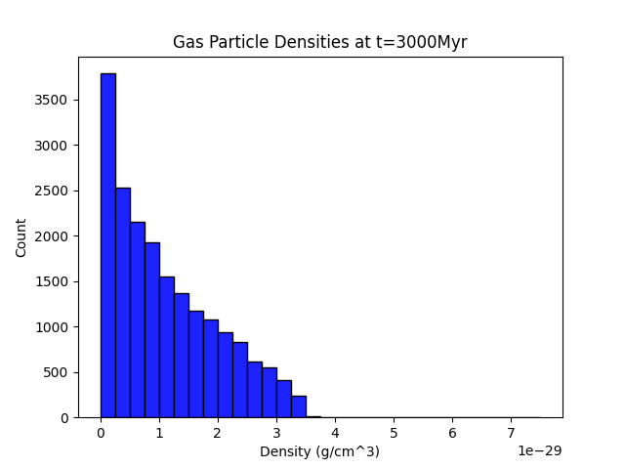
Gas density: Major merger - frontal
Densities required for star formation ~ (Mo, van den Bosch, White, 2010)
Jj
→ Densities increase short-term

Slide 13
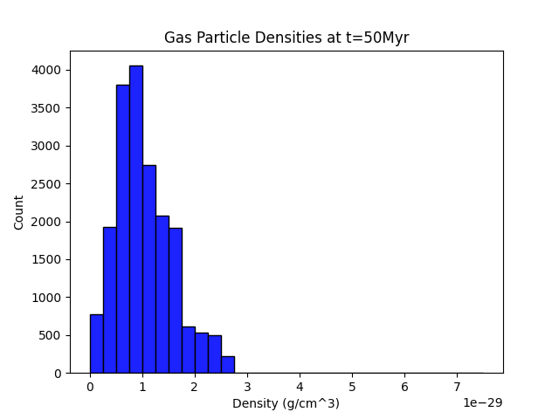
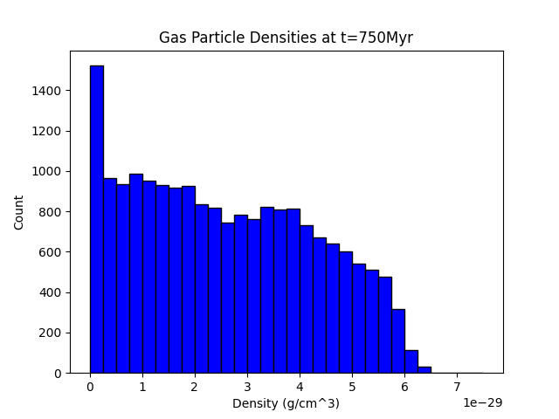
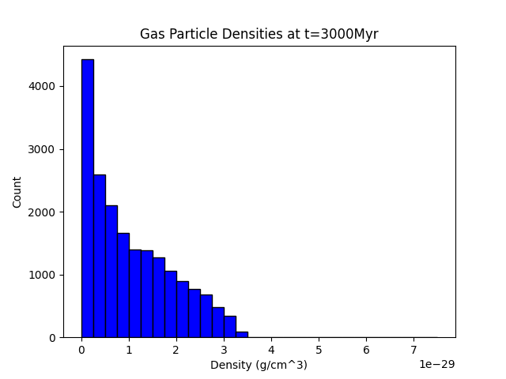
Gas density: Major merger - with rotation
Densities required for star formation ~ (Mo, van den Bosch, White, 2010)
Jj
→ Densities increase short-term

Slide 14
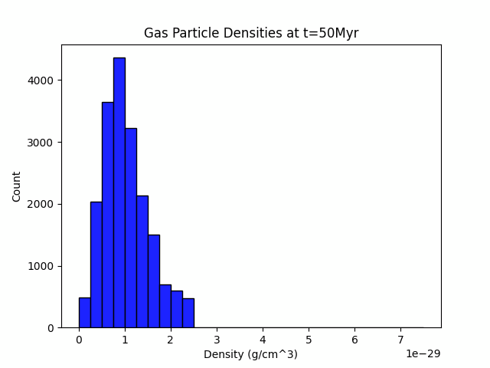
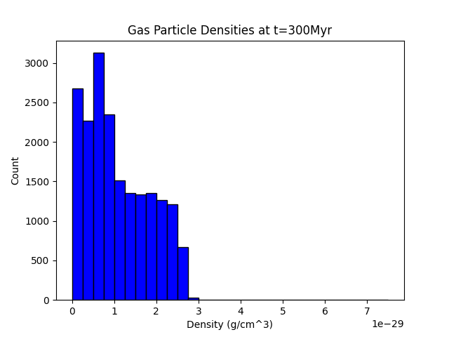
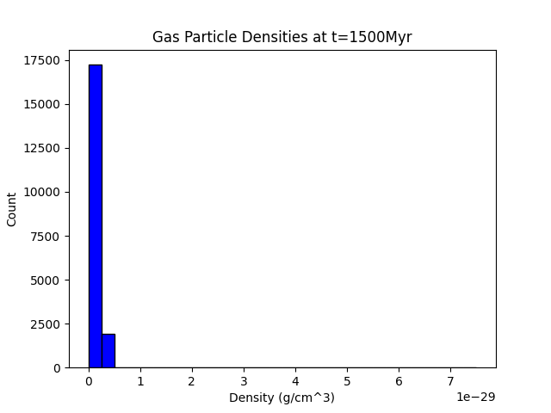
Gas density histograms: Minor merger
Densities required for star formation ~ (Mo, van den Bosch, White, 2010)
Jj
→ Densities become much much lower due to galaxies grazing each other

Slide 15
Conclusion
Densities of major mergers actually become about as low after merger than before merger
The newly formed galaxy is just as quenched than the initial two
Minor merger strips galaxies of gas
At the time of the merger the densities are highest, but with our resolution not high enough for star formation or a short term starburst
Outlook:
More resolution might yield better results, as local over-densities and perturbations in the central gas region could be resolved

Slide 16
Questions?

